Slide 1
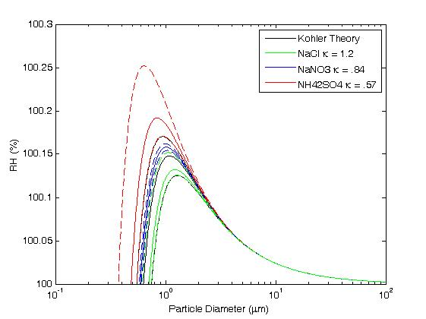
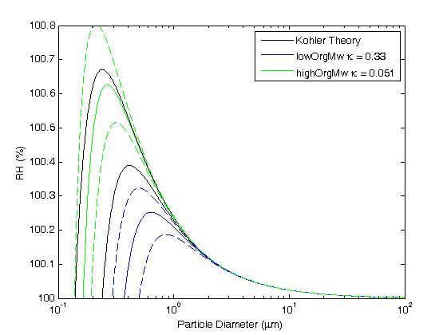
(NH₄)₂SO₄ (κ=0.61)
The Kohler curves from Lowest to highest S_{c} are NaCl, NaNO₃ and (NH₄)₂SO4 respectively. Dotted lines represent the range of k values in the literature.
NaNo₃ (κ=0.88)
NaCl (κ=1.28)
The Kohler curves from Lowest to highest S_{c} are low organic Mw (malonic acid)
and high organic Mw (fulvic acid ) respectively. Van’t Hoff factor (i) = 1 for organics.
Notes:
HighorgMW = fulvic acid , lowOrgMW= malonic acid(~3-hydroxybutyric acid)

Slide 2




Kohler Theory
Κ-Kohler Theory
$$S=a_{w}exp\left(\frac{2σ_{lv}}{ρ_{l}R_{v}T}\right)$$
$$\frac{1}{a_{w}}=1+\frac{κV_{s}}{V_{w}}$$
$$S=\left(1−\frac{3iM_{v}m_{s}}{4πM_{s}ρ_{l}r_{T}^{3} }\right)exp\left(\frac{2σ_{lv}}{ρ_{l}R_{v}T}\right)$$
$$a_{w}=1−\frac{3iM_{v}m_{s}}{4πM_{s}ρ_{l}r_{T}^{3} }$$
$$a_{w}=1−\frac{3iM_{v}m_{s}}{4πM_{s}ρ_{l}r_{T}^{3} }$$
$$a_{w}=\frac{V_{w}\left(1+\frac{(1−c{)V}_{s}}{V_{w}}\right)}{V_{w}+V_{s}}$$
$$\frac{1}{a_{w}}=1+\frac{cV_{s}}{V_{w}}$$
$$m_{s}=ρ_{s}\frac{4}{3}πr_{s}^{3}$$
$${\left(1+\frac{(1−c{)V}_{s}}{V_{w}}\right)}^{−1}≅\left(1−\frac{(1−c{)V}_{s}}{V_{w}}\right)$$
$\frac{iM_{v}ρ_{s}}{M_{s}ρ_{l}}= c=κ$
$$a_{w}=1−\frac{iM_{v}ρ_{s}\frac{4}{3}πr_{s}^{3}}{M_{s}ρ_{l}{\frac{4}{3}πr}_{T}^{3} }$$
$$a_{w}=\frac{V_{w}}{(V_{w}+V_{s})\left(1−\frac{(1−c{)V}_{s}}{V_{w}}\right)}$$
$$\frac{1}{a_{w}}=1+\frac{κV_{s}}{V_{w}}$$
$$a_{w}=1−\frac{iM_{v}ρ_{s}V_{s}}{M_{s}ρ_{l}V_{T}}$$
$$a_{w}=\frac{V_{w}}{V_{w}{−(1−c{)V}_{s}+V}_{s}−\frac{(1−c)V_{s}^{2}}{V_{w}}}$$
0
$$a_{w}=1−\frac{cV_{s}}{V_{T}}$$
$$a_{w}=\frac{V_{w}}{V_{w}+cV_{s}}$$
$$V_{T}=V_{w}+V_{s}$$
$$\frac{1}{a_{w}}=\frac{V_{w}+cV_{s}}{V_{w}}$$
$$a_{w}=\frac{D^{3}−D_{s}^{3}}{D^{3}−D_{s}^{3}\left(1−κ\right)}$$
$$a_{w}=\frac{V_{w}+V_{s}−cV_{s}}{V_{w}+V_{s}}$$

