Slide 1
Radiative Properties of Eastern Pacific Stratocumulus Clouds
Zack Pecenak
Evan Greer
Changfu Li

Slide 2
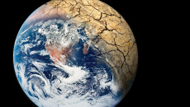
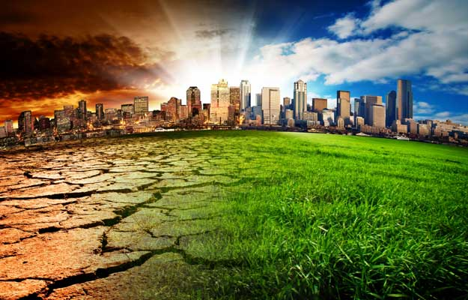
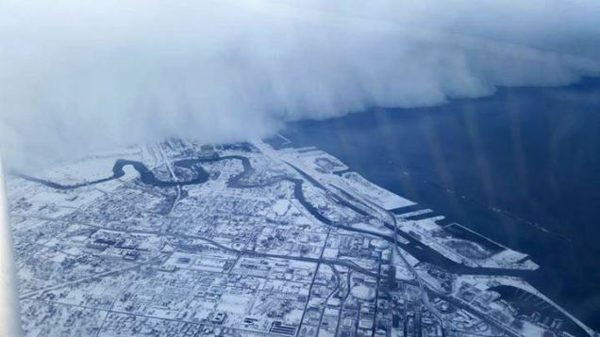
Climate Change - Implications
Problem
Ongoing climate change
Solution:
Climate engineering?
Notes:
-the reality of ongoing climate change prompts unconventional solutions
-climate engineering attempts to manipulate the climate itself to counteract warming and other problems
-climate engineering serves as a supplement to ongoing efforts to reduce humanity’s carbon footprint such as increasing viability of renewable energy resources and implementation of sustainability practices
-Examples of climate engineering include carbon sequestration, which is the capture and long term storage of atmospheric carbon dioxide and solar radiation management, which will be discussed next

Slide 3
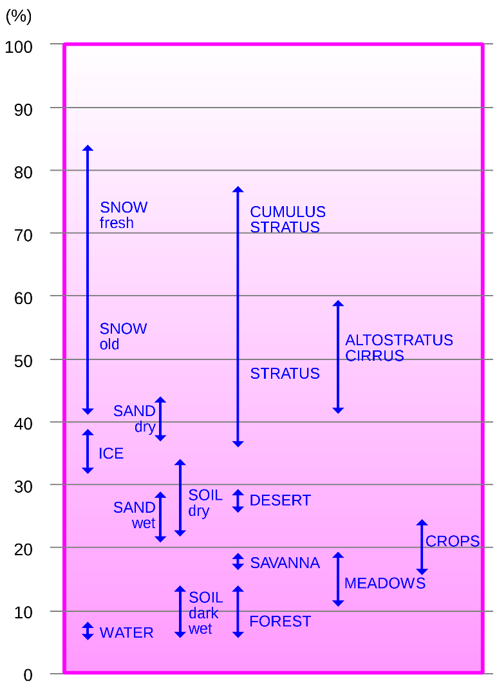
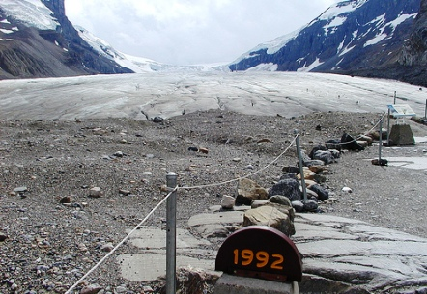
Solar Radiation Management
Increasing the albedo of snow or clouds is a form of SRM
Melting glacier
Clouds play large role
Note: albedo is proportional to height
Expect low clouds to cool better than high clouds
Notes:
- Solar radiation management attempts to adjust the amount of surface radiation by controlling radiation and heat reflected to space
Snow and glaciers as well as clouds have relatively high albedos and contribute significantly to the overall reflection of the radiation to space
For example, the melting of glaciers cause the overall albedo of the earth to decrease resulting in a positive feedback where rising surface temperature results in more melting
Clouds can be used as a medium for solar radiation management. Understanding the properties of clouds is key to developing effective solar radiation management methods

Slide 4
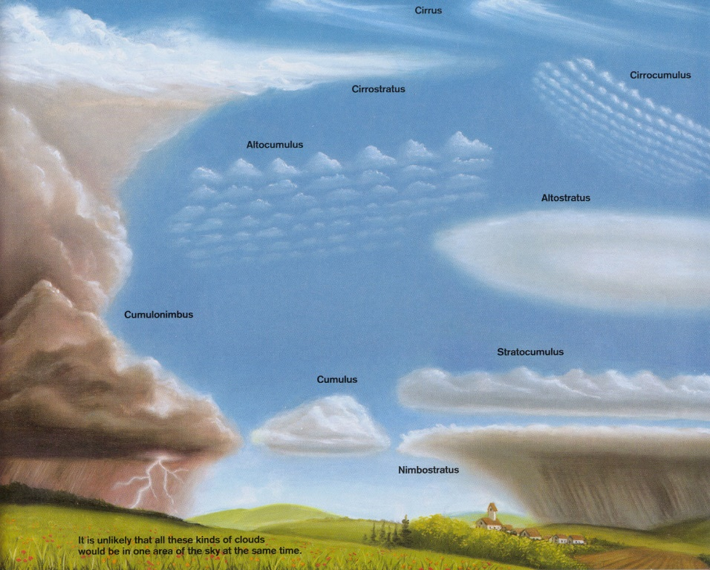
Radiative Forcing
Solar insolation
Reflected
shortwave
Transmitted radiation
Absorbed shortwave
Notes:
- clouds drive radiative forcing within the atmosphere by reflecting shortwave radiation and absorbing longwave radiation
Interaction of clouds with the incoming solar radiation is complicated by the various spatial scales involved:
Individual clouds vs. cloud systems
Variety of cloud types
The effect of clouds on heating rates

Slide 5
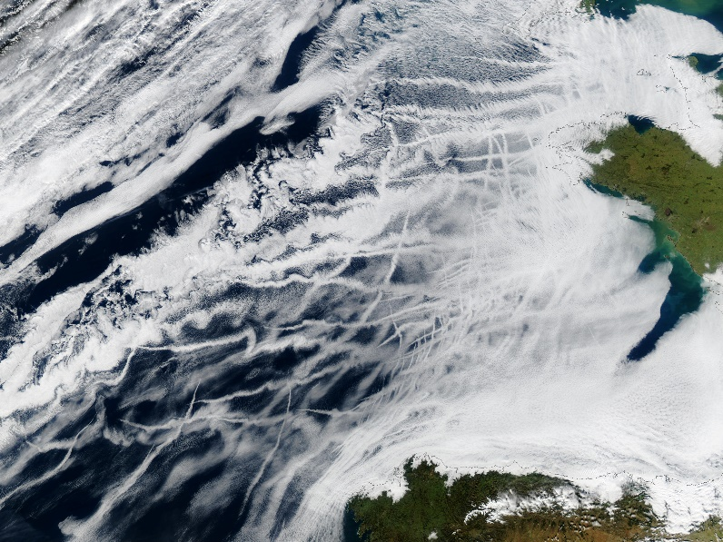
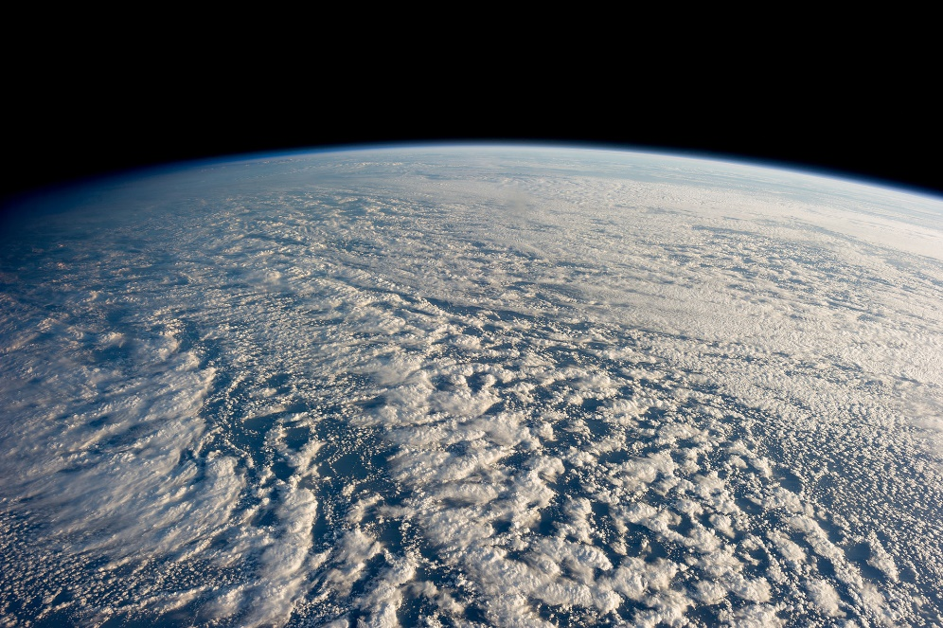
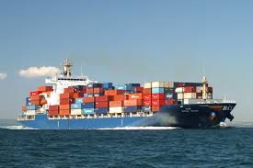
Eastern Pacific Marine Stratocumulus
Perturbations in aerosol levels cause the formation of ship tracks

Slide 6
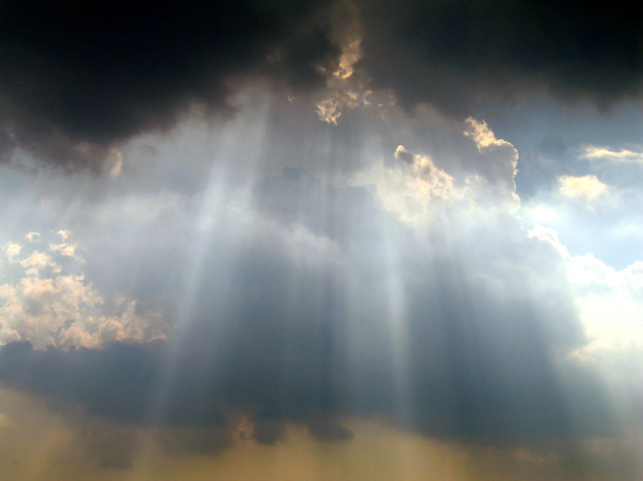
Description of the Radiative Model
The model can be broken into two phases
Investigation of cloud properties
Investigation of radiative properties
Radiation Flux Data
Droplet Data
Cloud Properties Radiative Properties
Relation to Climate

Slide 7
Cloud Properties
Measured Droplet data from airplane
Can use data to derive several properties of clouds
Total number concentration: $N=\int_{0}^{∞}{n\left(r\right)dr}≈∑n(r)$
Liquid water mixing ratio: $w_{l}=\frac{ρ_{l}}{ρ_{a}}\frac{4}{3} π \int_{0}^{∞}{r^{3}n\left(r\right)dr}$
Liquid water path: $Wl=\int_{Z_{cb}}^{Z_{ct}}{ρ_{a}}w_{l}dz$
Mean droplet radius: $\overline{r}=\frac{\int_{0}^{∞}{n\left(r\right)rdr}}{\int_{0}^{∞}{n\left(r\right)dr}}≈\frac{n ∙r}{N}$
Effective radius: $r_{e}=\frac{\int_{0}^{∞}{n(r)r^{3}dr}}{\int_{0}^{∞}{n(r)r^{2}dr}}$
Figure 1: Droplet distribution from Lu. et al. (2009) The red curve was taken as the distribution for an "undisturbed" cloud

Slide 8
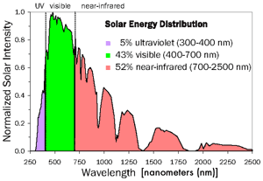
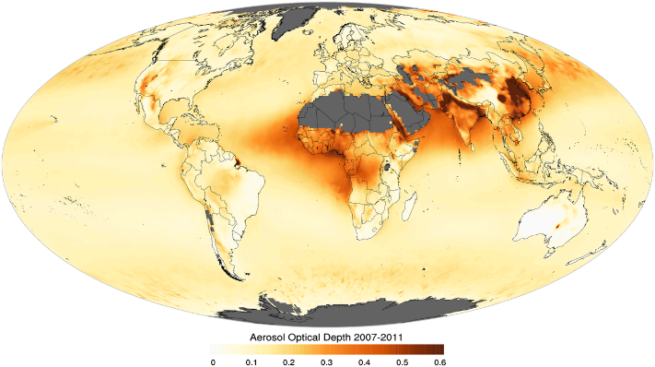
Cloud Properties: Leading to Radiation
Extinction Coefficient
Measure of light that is scattered or absorbed
$σ_{ext}=π\int_{0}^{∞}{r^{2}n\left(r\right)dr}Q_{ext}\left(X\right)dr$
$Q\left(X\right)≈2$ (short wavelength, large radius)
Optical Depth
Measure of resistance to radiation traveling through a cloud
$τ_{opt}=∫σ_{opt}dz=\frac{3Wl}{2ρ_{l}r_{e}}$

Slide 9
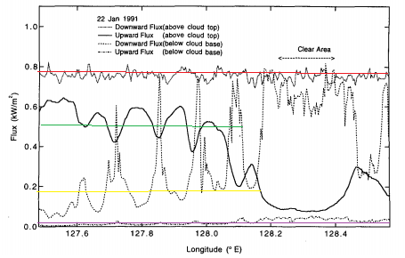
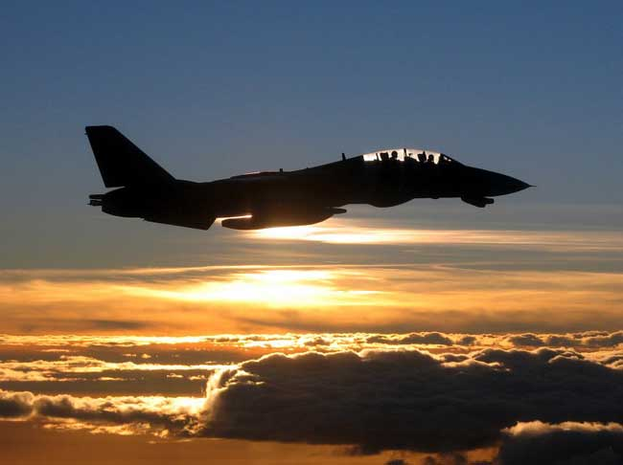
Radiative Properties
Flux measurements
Cloud top
Cloud Bottom
Figure 2: Longwave radiation balance from Nicholls (1984). The blue lines represent the cloud top and bottom. The orange lines represent the flux values.
Figure 3: The solar flux as measured by Hayasaka et al 1985. The colored lines represent the average of each of the measured fluxes.
Airplanes equipped with radiometer measured fluxes at the top and bottom of clouds
Different radiometers for different $λ$range

Slide 10
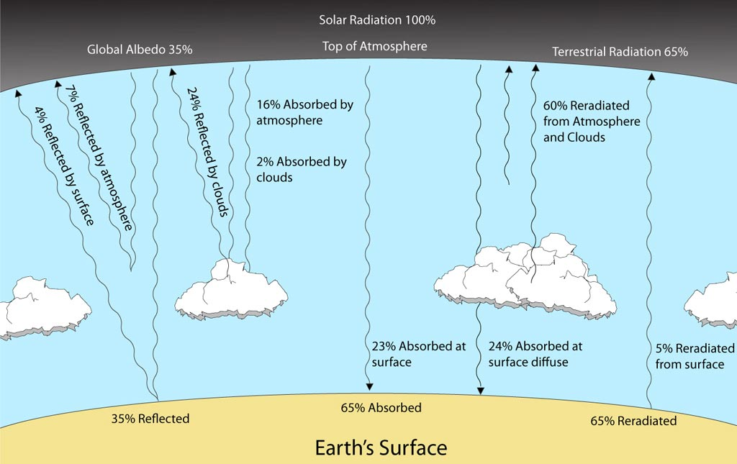
Radiative Properties: Relation to Climate
Cloud properties affect mean temperature budget
Solar and Longwave
Absorptivity $A$
Reflectivity $R$
Transmissivity $T$
Heating Rate
$\frac{dT}{dt}=\frac{1}{ρc_{p}}\frac{dF}{dz}≈\frac{1}{ρc_{p}}\frac{\left(F_{net,ct}−F_{net,cb}\right)}{z_{ct}−z_{cb}}$
$$A+T+R=1$$
Radiation in = Radiation out

Slide 11
Model Assumptions and Shortcomings
Assumptions:
Cloud sample is proper representation of total cloud
Eastern Pacific MS have similar properties to Western Pacific MS
Droplet distribution and fluxes come from similar cloud
Shortcomings
Numerical integration scheme has low accuracy
Part 1 and Part 2 are uncoupled

Slide 12
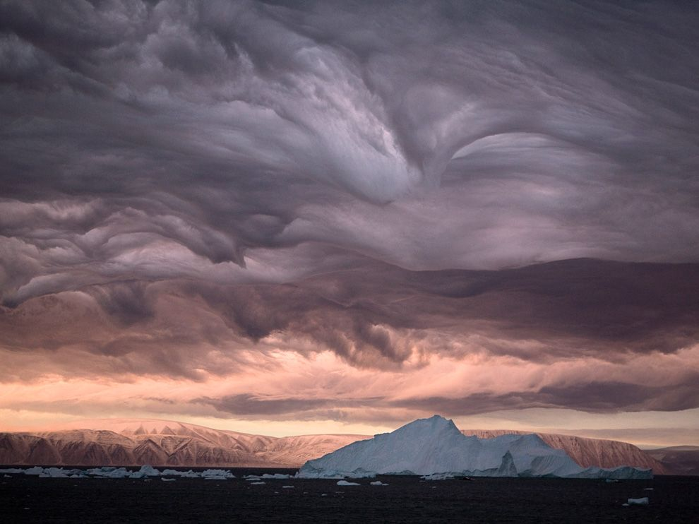
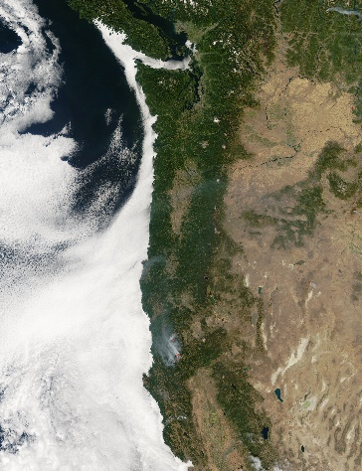
Case Study
Sensitivity analysis
Vary droplet radius concentration n(r)
See affect on cloud properties
Radiative comparison
Compare two clouds
Arctic Stratus
Eastern Pacific Marine Stratocumulus
How do these clouds affect global temperature?
Relation to droplet size?

Slide 13
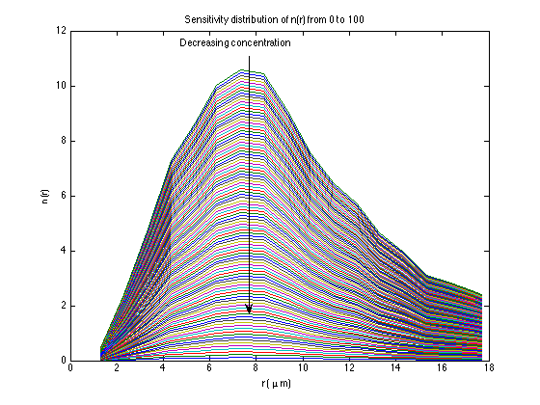
Sensitivity study
Plot of particle size distribution for EPMS
Varying the concentration from 0 to 100 times the measured

Slide 14
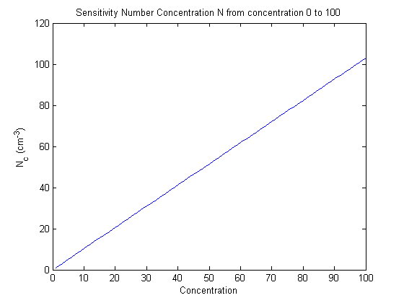
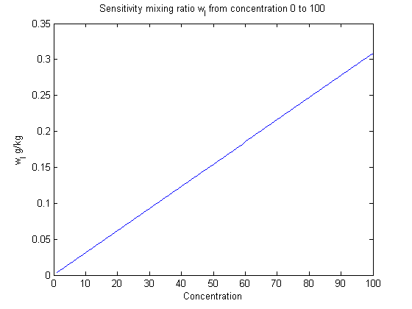
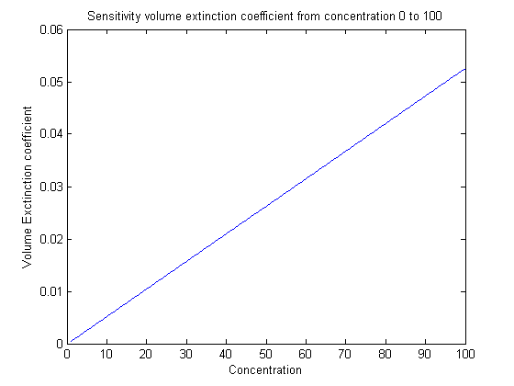
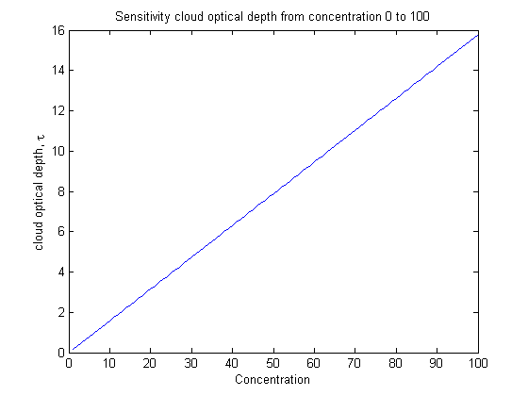
Sensitivity Study – Cloud Properties
Linear dependence
Expected since n(r) is varied linearly

Slide 15
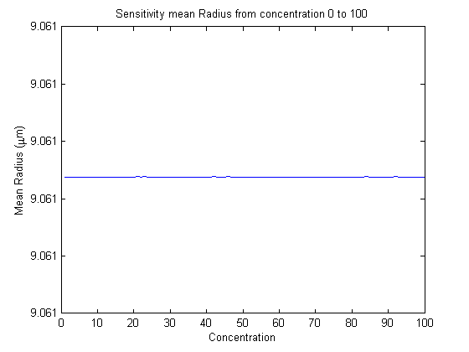
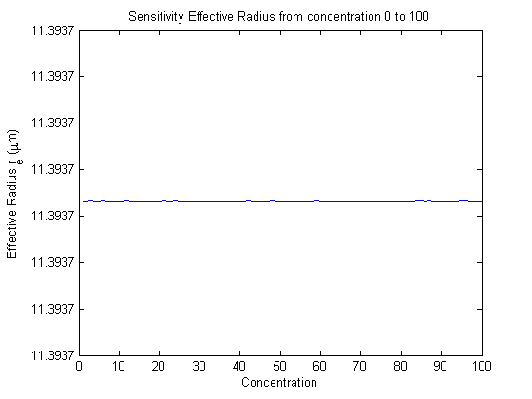
Sensitivity Study – Cloud Properties
No change
Expected
Concentration changes, distribution is constant

Slide 16
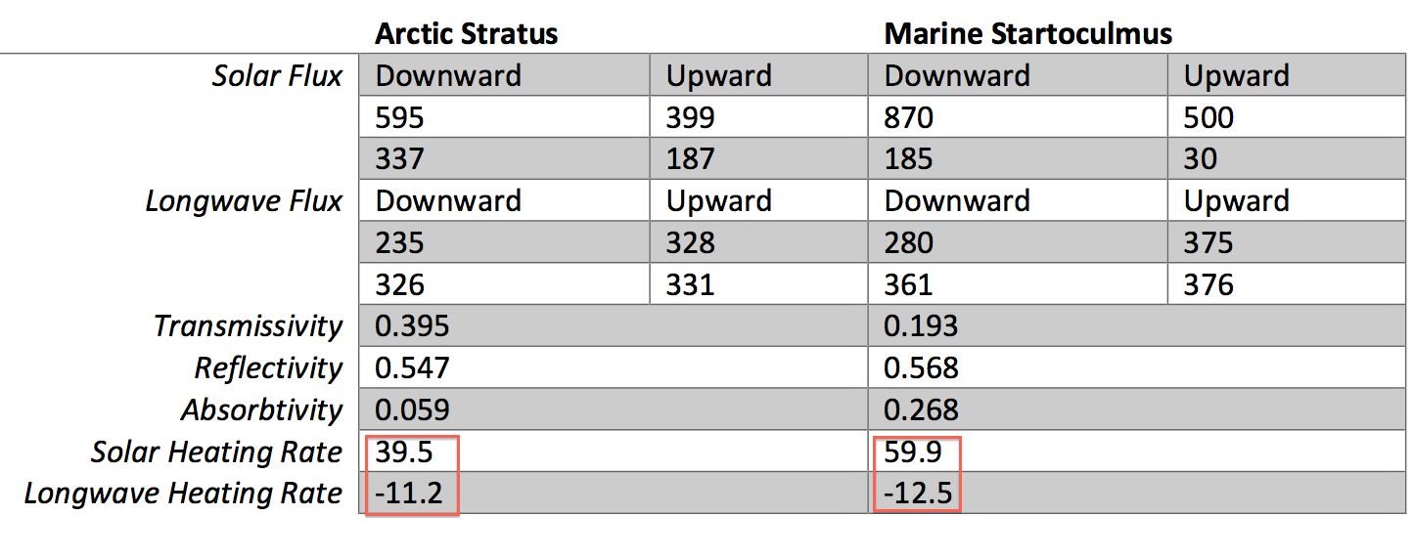
Radiative Properties - Comparison
Heating Rate – Liquid Water Path Feedback
Heating rate
Liquid Water Path
Optical depth
Radiation Transmission
Notes:
Facts:
1, for every cloud, solar heating rate is positive and long wave heating rate is negative
2, sun emits short wave radiation, cloud emits long wave radiation
Conclusion:
Radiative heating is mainly caused by absorbtion of shortwave radiation by cloud
Radiative cooling is mainly caused by emitting of long wave radiation by cloud
Comparing two type of clouds:
1, The absorbtivity for Arctic Stratus is 0.056, for Marine Startoculmus is 0.268,
Marine Startoculmus absorbs more incoming solar radiation, which leads to higher heating
rate.
2, Marine Startoculmus absorbs more incoming solar radiation, then it will emit more long
wave radiation, which leads to increasing escaping long wave radiation, thus decreasing the
net radiation coming into the earth, which will leads to cooling.
So from the prospective of cooling the earth, it’s better to have more Arctic Stratus Cloud

Slide 17
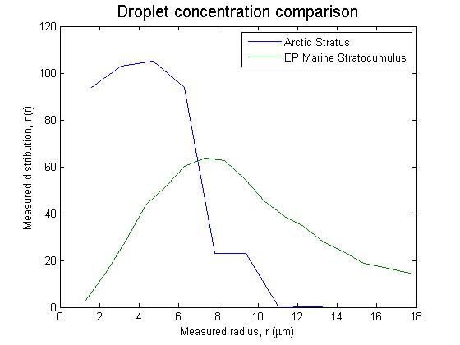
Radiative Properties –Cloud Properties
Arctic Stratus
EP Marine Stratocumulus
Observations:
EPMS has
lower transmissivity
higher reflectivity
Higher absorptivity
Less radiation reaches surface than AS
Observations:
EPMS
larger droplets
smaller distribution
Thicker cloud compared to AS
Varying droplet concentration and distribution affects radiative properties
By increasing particle size and decreasing distribution a radiation management scheme is found

Slide 18
Conclusions - Relation to Climate Change
Radiation balance within clouds is dependent on cloud properties
Same type, different properties
Different types, different properties
Feedback effect
Radiation properties are related to cloud properties
$\frac{dQ}{dt}→W_{l}→τ_{opt}→Radiation$
Clouds can (and should) be used for radiation management
Vary cloud properties (artificially)

Slide 19
Thank You
We would like to thank Dr. Russell for assigning us the project, as well as all of the reviewers whose review contributed to the quality of our work!

