Slide 1
Simulation of volcanic effects on global solar insulation model
Mari Masdal, Jonas Coyet, Morven Muilwijk & Nikolai Aksnes 2013
SIO 217a Atmospheric and Climate Sciences I

Slide 2
Introduction
Model & theory
Effects of volcanic eruptions on insolation
Implementing the effect of volcanoes in our model
Results
Conclusion

Slide 3
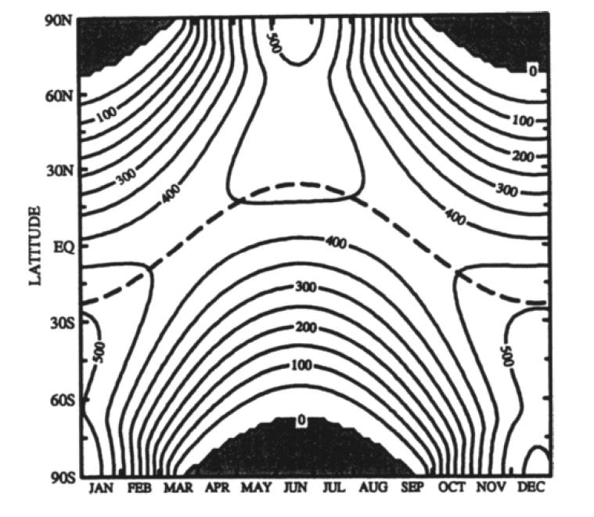
Introduction
Reproduce fig. 12.3 in “Thermodynamics of Atmospheres & Oceans”
Show the effect of the recent volcanic eruption in Iceland in this model and compare to the Pinatubo and El Chichon eruptions

Slide 4
Mean insolation at a given time and latitude
Lines of constant solar heat flux
Polar nights
Seasons due to declination angle and elliptical earth orbit

Slide 5
Theory and model
The mean daily insolation (curve values in the plot) is given by:
Where S is the solar flux and is calculated from
f is the square of the mean sun-earth distance
Z is the solar zenith angle

Slide 6
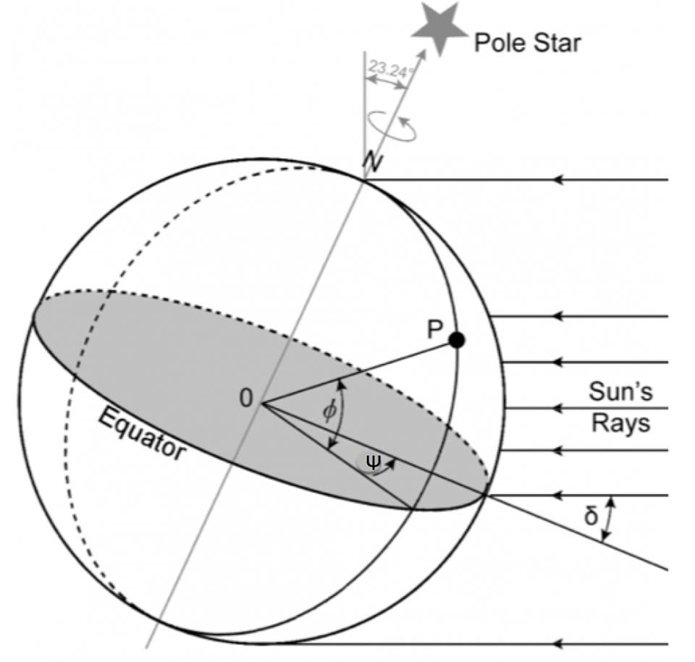
Solar zenith angle
The solar zenith angle depends on the latitude, season and time of day
Hour angle ψ
Declination angle δ
Latitude Φ

Slide 7
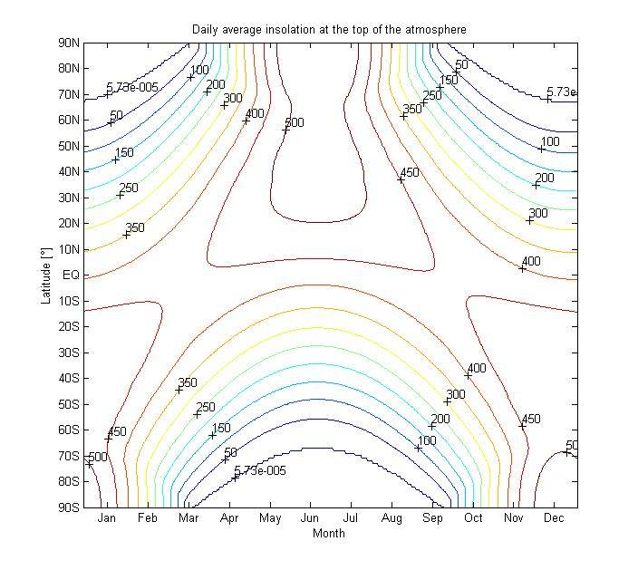
Model reproduction

Slide 8
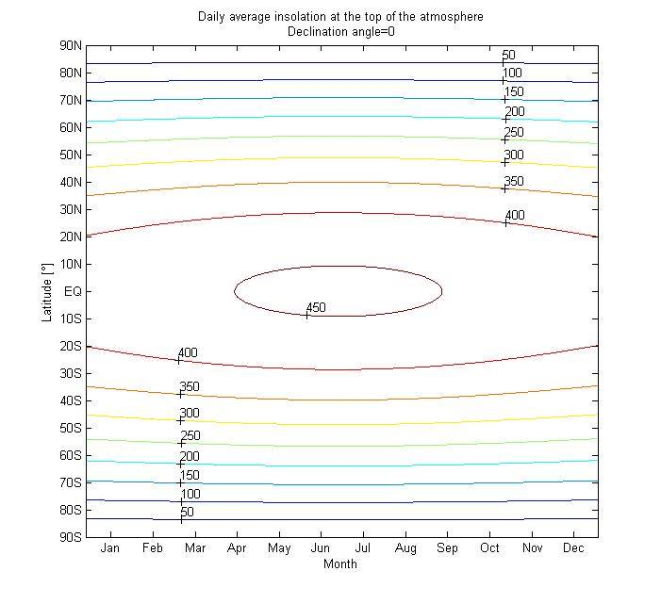
Seasons due to declination angle

Slide 9
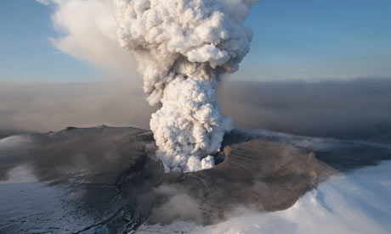
Volcano eruptions and climate
Ways volcanos affects climate:
Increased greenhouse effect
Local covering due to ash clouds
Cooling effect due to sulfur aerosols
“Eruption size V.S. amount of sulfur emitted“

Slide 10
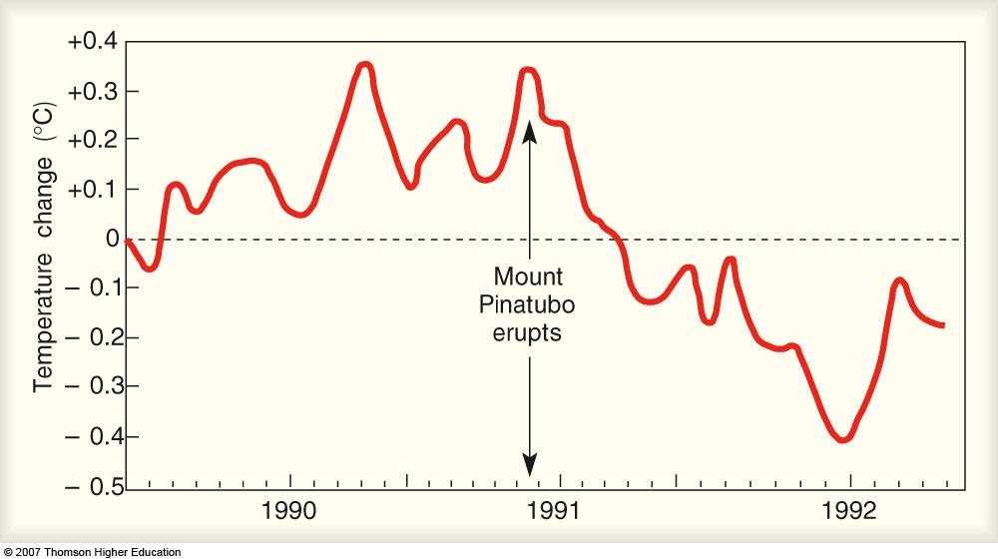
Cooling due to sulfur aerosols «Haze effect»
Sulfur + water vapor → sulfuric acid
→ Dense clouds of H2SO4 dropplets
→ Efficient scattering → Increased albedo

Slide 11
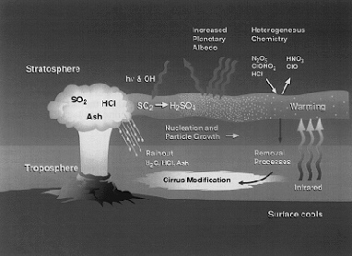

Slide 12
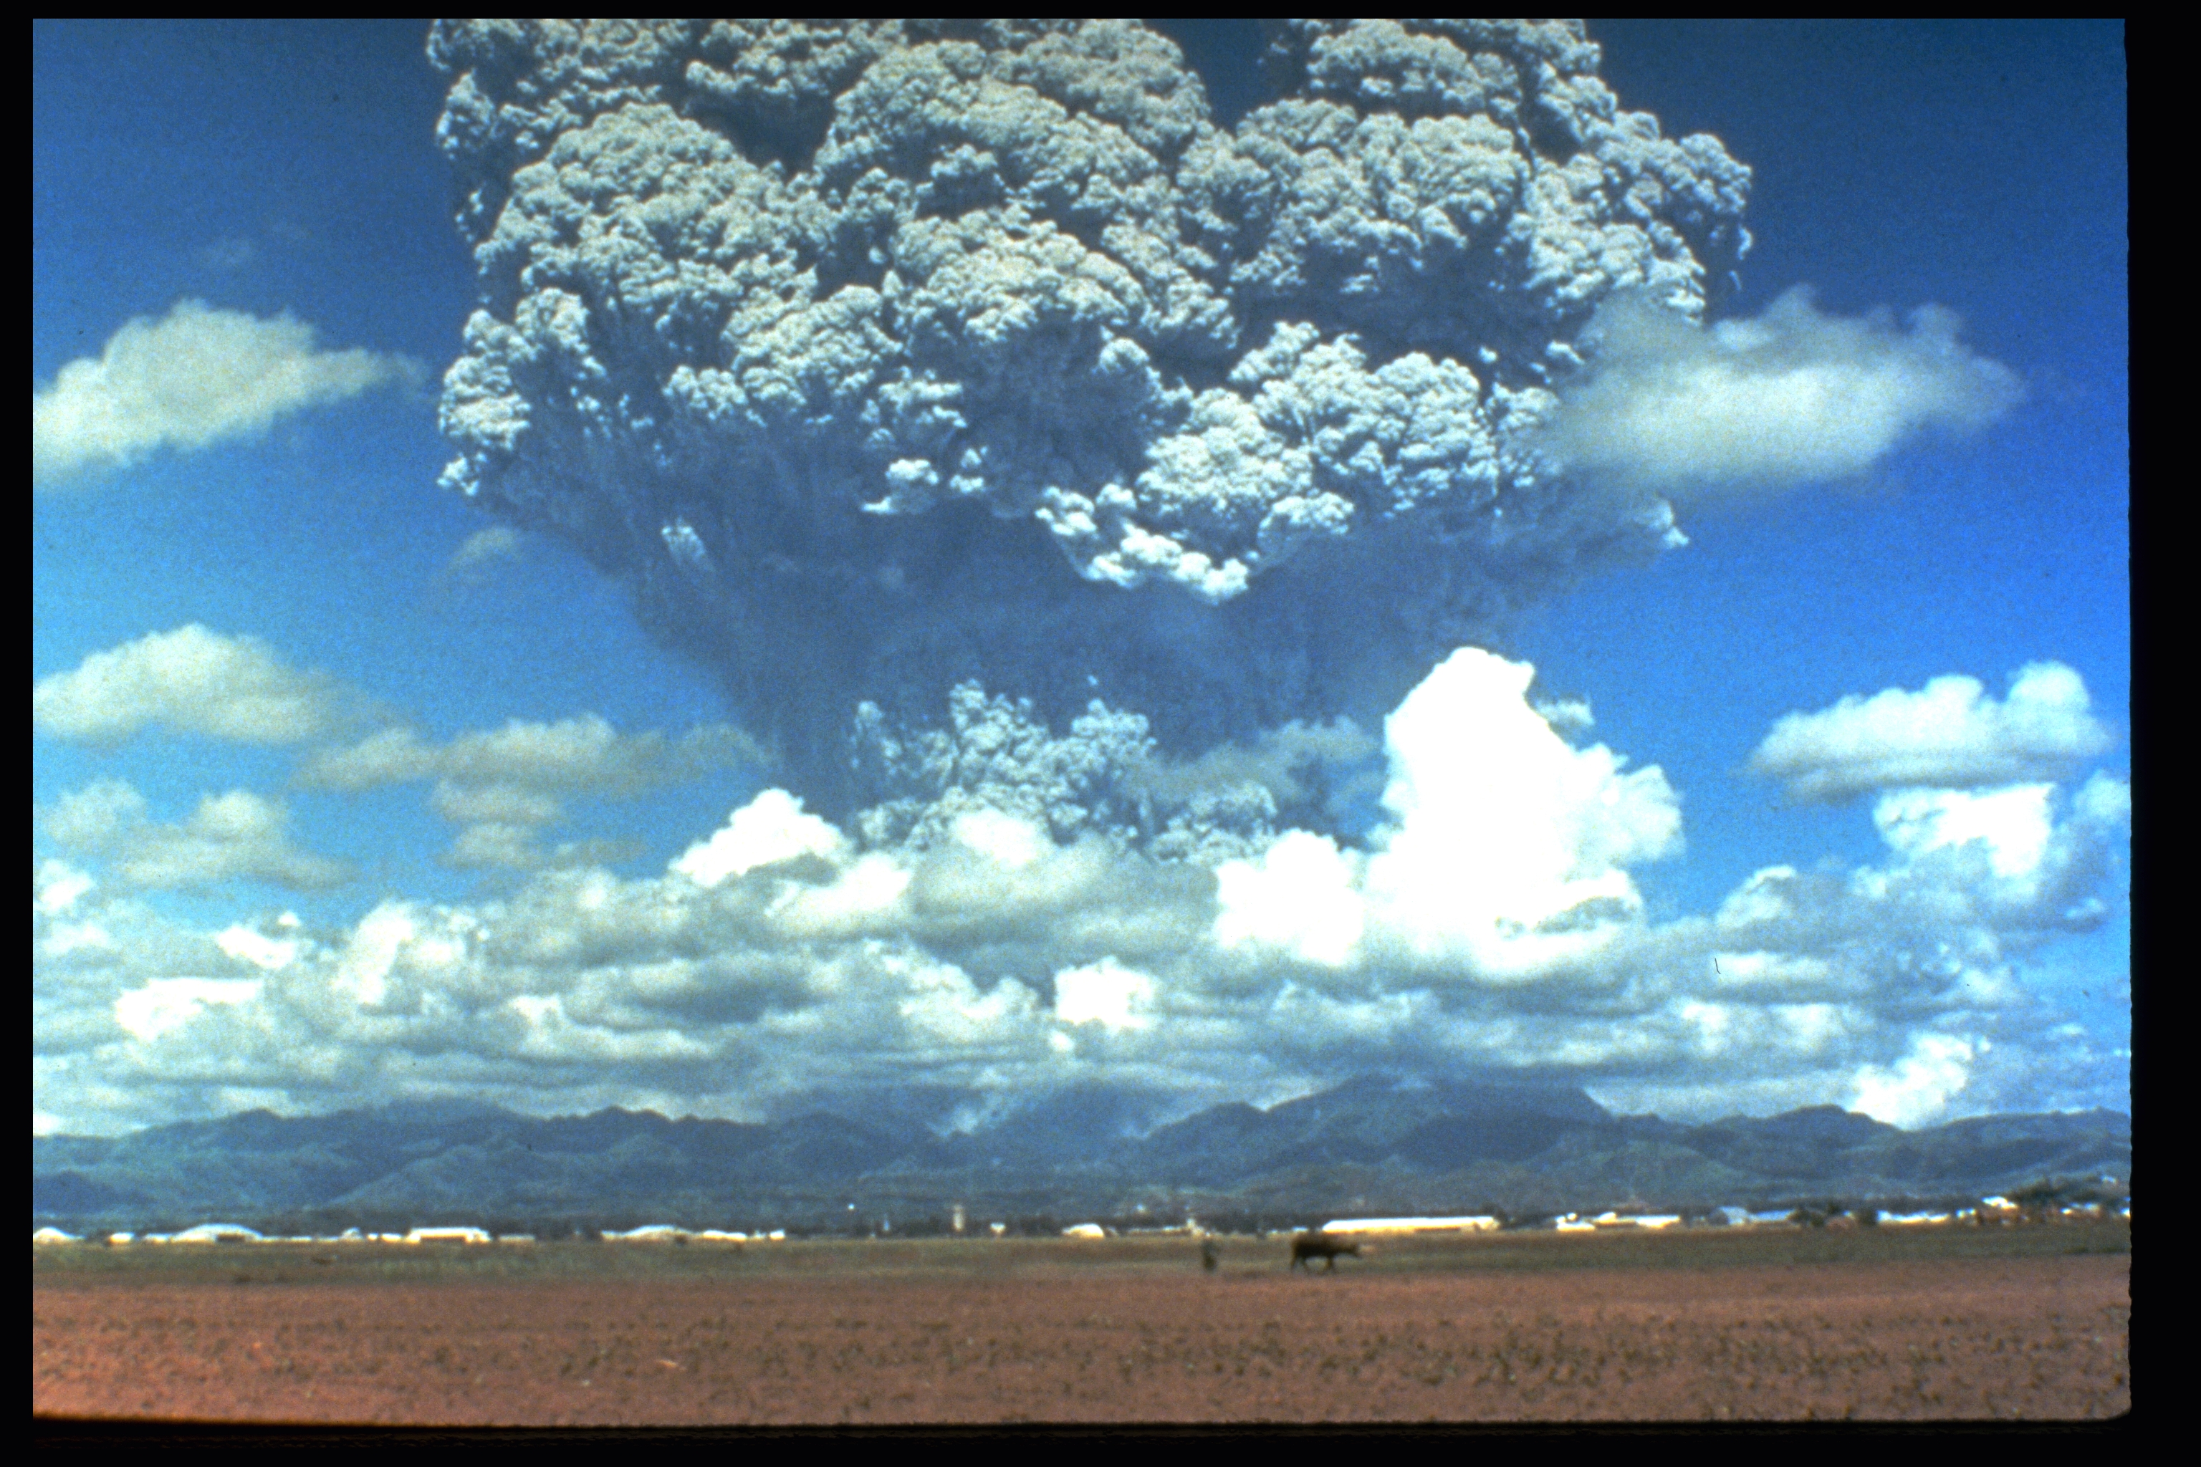
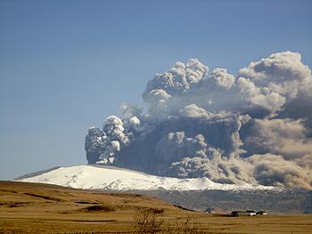
Pinatubo eruption and Eyafjallajokull eruption
Pinatubo, 1991 Philiphines
Eyafjallajokull, 2010 Iceland
20,000,000 tonnes sulfur emmited Global mean temperature dropp of 0.5 C over 1-3 years
Approx. 10-15,000 tonnes sulfur emitted. Climate effect?

Slide 13
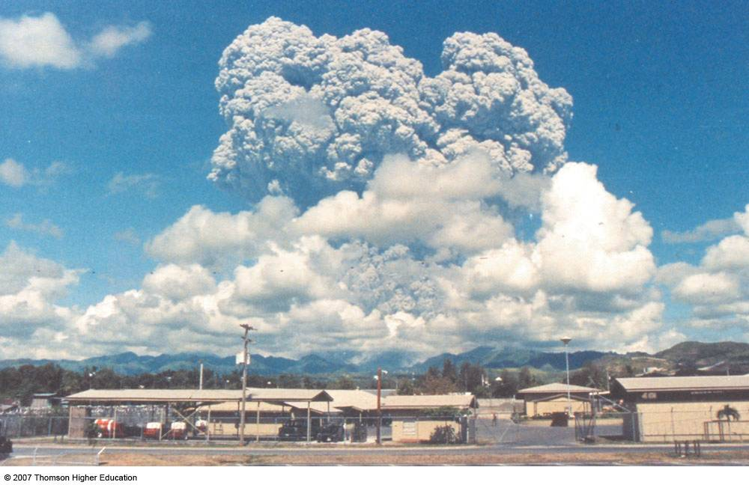
El Chicon, 1982 Mexico
~7,000,000 tonnes sulfur emmited smaller climate effect

Slide 14
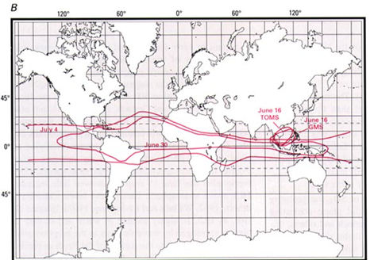
Spreading of the Pinatubo aerosol cloud

Slide 15
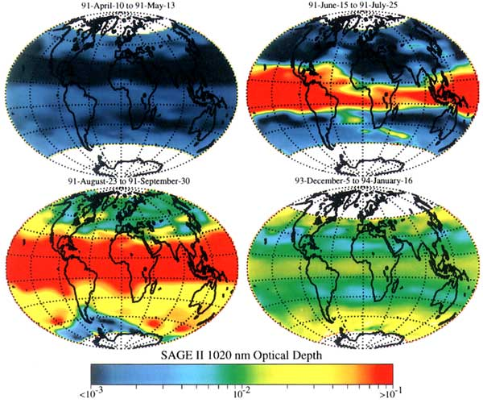
Spreading of the Pinatubo aerosol cloud

Slide 16
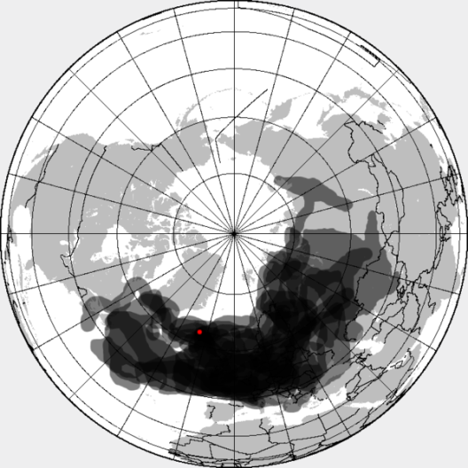
Iceland ash cloud spreading
Huge cloud, but why no climate effect?

Slide 17
Simulating the effect of Pinatubo in our model
Why we choose Pinatubo for our simulation?
Possible change: difference in albedo
Global measurements: - Decrease in global mean tempearature 0.5 C
Ship measurements: - solar flux insolation decreased with 1.4%-4.1% - optical thickness increased from 0.1 to 0.3
Assumption: all change in insolation is due to sulfur aerosols (netto effect)

Slide 18
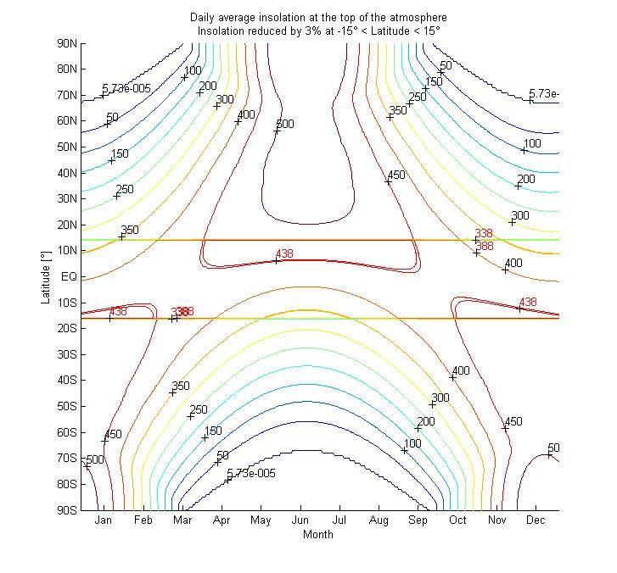
Approach 1 : equatorial
Decrease in solar insolation
of 1.4%-4.1%

Slide 19
Using Simplified Climate Model

Slide 20
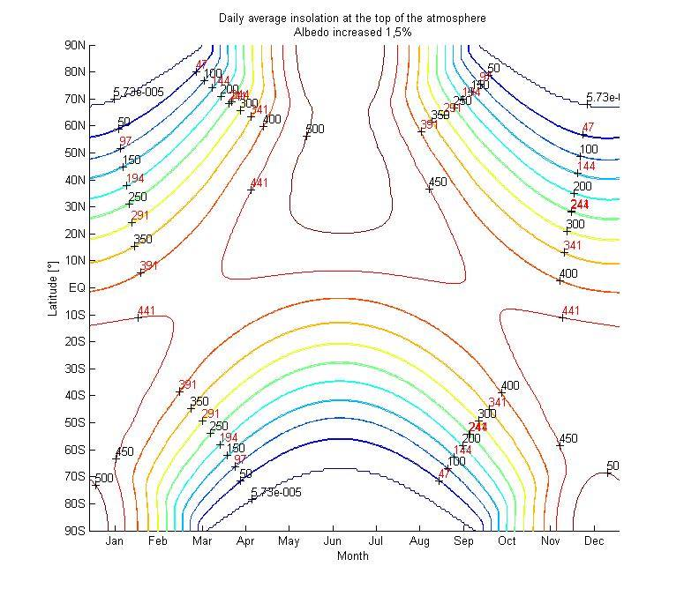
Approach 2: Decrease in global albedo of 1.5% based on average temp increase at surface

Slide 21
Summary and conclusion
We have successfully reproduced the model
→ Even though our two approaches differ some in result we approximate them to give the same average result

