Slide 1
APPLICATION OF KOHLER THEORY: MODELING CLOUD CONDENSATION NUCLEI ACTIVITY
Gavin Cornwell, Katherine Nadler, Alex Nguyen, and Steven Schill

Slide 2
Overview
Introduction
Model description and derivation
Sensitivity experiments and model results
Discussion and conclusions

Slide 3
Atmospheric aerosol processes
reaction
activation
H₂O
coagulation
condensation
evaporation

Slide 4
Climate effects
Direct Effect
Indirect Effect
Factors
Composition
Phase
Size
+ H₂O
Earth’s Surface

Slide 5
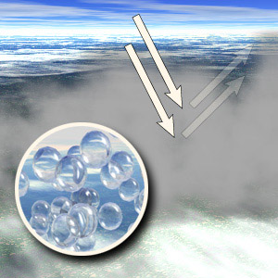
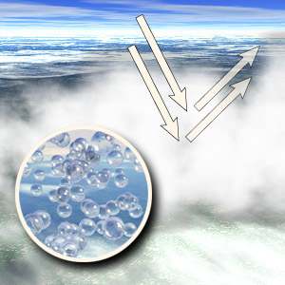
Cloud particle size
Large particle droplets
Small particle droplets
http://terra.nasa.gov/FactSheets/Aerosols/

Slide 6
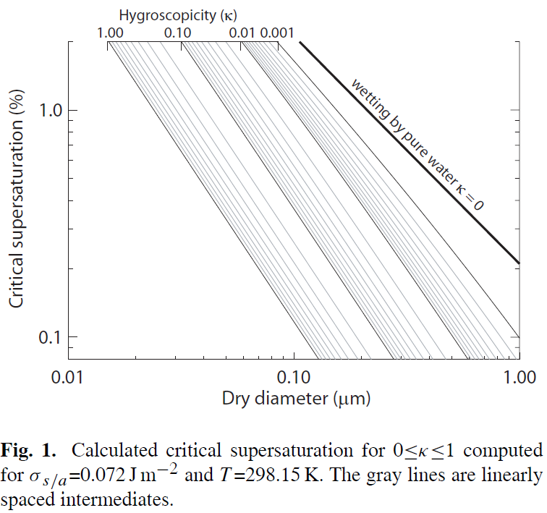
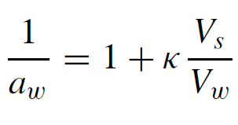
κ-Kӧhler Theory
Petters and Kreidenweis (2007) Atmos. Chem. Phys. 7, 1961

Slide 7
Overview
Introduction
Model description and derivation
Sensitivity experiments and model results
Discussion and conclusions

Slide 8
Kӧhler Theory
Kelvin Effect
Size effect on vapor pressure
Decreases with increasing droplet size
Raoult Effect
Effect of dissolved materials on dissolved materials on vapor pressure
Less pronounced with size
$$b=\frac{3iM_{v}n_{s}}{4πρ_{l}}$$
$a=\frac{σ_{lv}}{ρ_{l}R_{v}T}$

Slide 9
Model Scenario
Particle with soluble and insoluble components

Slide 10
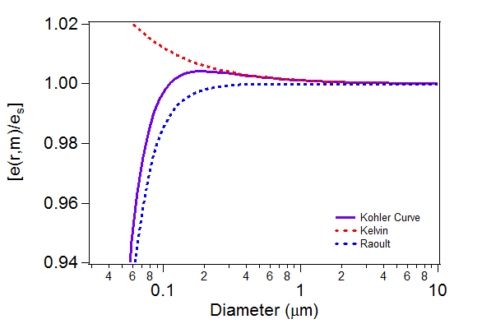
Model
MATLAB
Inputs
Total mass of particle
Mass fraction of soluble material
Chemical composition of soluble/insoluble components
Calculate S for a range of wet radii using modified Kӧhler equation

Slide 11
Assumptions
Soluble compound is perfectly soluble and disassociates completely
Insoluble compound is perfectly insoluble and does not interact with water or solute
No internal mixing of soluble and insoluble
Particle and particle components are spheres
Surface tension of water is constant
Temperature is constant at 273 K (0°C)
Ignore thermodynamic energy transformations

Slide 12
Raoult Effect
i is the Van’t Hoff factor
Vapor pressure lowered by number of ions in solution
Curry & Webster equation 4.48

Slide 13
Raoult Effect (cont.)
n = m/M m = (V*ρ)

Slide 14
Raoult Effect (cont.)
V_{sphere} = 4πr³/3
Calculated r_{i} from (V_{i}=m_{i}/ρ_{i})
Solute has negligible contribution to total volume

Slide 15
Modified Kӧhler Equation
Combine with Kelvin effect

Slide 16
Replication of Table 5.1

Slide 17
Model Weaknesses
No consideration of partial solubility
Neglects variations in surface tension
More comprehensive models have since been developed (κ-Kӧhler) but our model still explains CCN trends for size and solubility

Slide 18
Overview
Introduction
Model description and derivation
Sensitivity experiments and model results
Discussion and conclusions

Slide 19
Mass dependence test
C₆H₁₄
NaCl
constant mass fraction of soluble/insoluble
insoluble component takes up volume, but does not contribute to activation
total mass = 10⁻²¹ – 10⁻¹⁹ kg

Slide 20
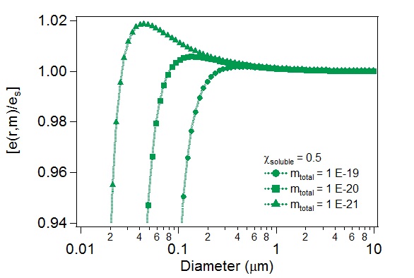
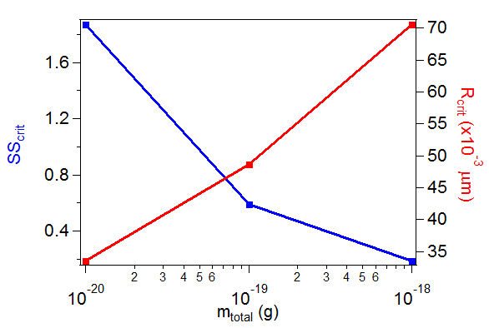
Mass dependence test
More massive particles have larger r* and lower S*

Slide 21
Mass fraction dependence
constant total mass
vary fraction of soluble component
NaCl
C₆H₁₄

Slide 22
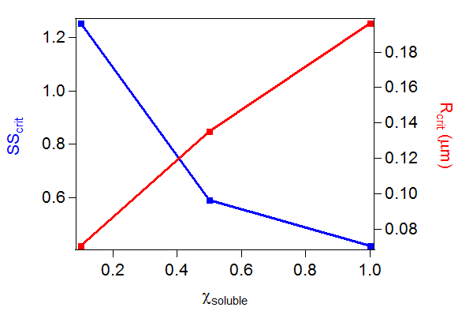
Mass fraction dependence
Greater soluble component fraction have larger r* and lower S*

Slide 23
Chemical composition dependence
constant total mass
vary both χ_{s} and i to determine magnitude of change for mixed phase and completely soluble nuclei
i = 2 NaCl 58.44 g/mol
4 FeCl₃ 162.2 g/mol

Slide 24
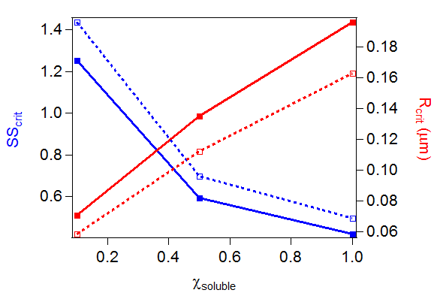
Chemical composition dependence
Larger van’t Hoff factor have smaller r* and higher S* for each soluble mass fraction

Slide 25
Overview
Introduction
Model description and derivation
Sensitivity experiments and model results
Discussion and conclusions

Slide 26
Discussion of Modeled Results
Sensitivity factors
Total mass
Fraction of soluble
Identity of soluble
Impact on SS_{crit}

Slide 27
Implications
Mixed phase aerosols are more common, models that incorporate insoluble components are important
Classical Köhler theory does not take into account insoluble components and underestimates critical supersaturation and overestimates critical radius

Slide 28
Conclusion
The Köhler equation was modified to account for the presence of insoluble components
$$\frac{e_{s}\left(r,{ n}_{solt}\right)}{e_{s}}=\left(1−\frac{b}{r^{3}−r_{i}^{3}}\right)exp(a/r)$$
While the model is incomplete, the results suggest that as fraction of insoluble component increases, critical supersaturation increases
More complete models exist, such as the κ-Köhler

Slide 29
References
[1] Ward and Kreidenweis (2010) Atmos. Chem. Phys. 10, 5435.
[2] Petters and Kreidenweis (2007) Atmos. Chem. Phys. 7, 1961.
[3] Kim et. al. (2011) Atmos. Chem. Phys. 11, 12627.
[4] Moore et. al. (2012) Environ. Sci. Tech. 46 (6), 3093.
[5] Bougiatioti et. al. (2011) Atmos. Chem. Phys. 11, 8791.
[6] Burkart et. al. (2012) Atmos. Environ. 54, 583.
[7] Irwin et. al. (2010) Atmos. Chem. Phys. 10, 11737.
[8] Curry and Webster (1999) Thermodynamics of Atmospheres and Oceans.
[9] Seinfeld and Pandis (1998) Atmospheric Chemistry and Physics.

